Slide 1


This slide is fine as it is
November 2017

Slide 2

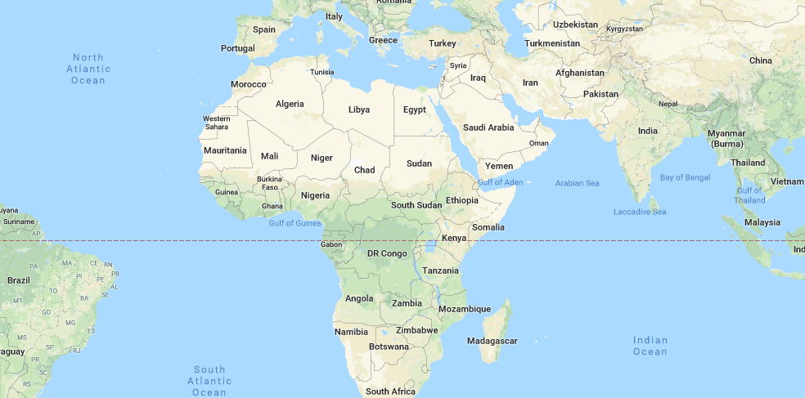

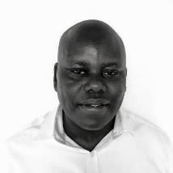
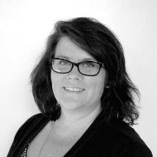
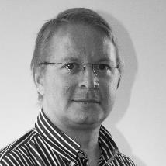
An international technology company focused on solutions that improve life in urban Africa
Nerica – not sure this slide works design-wise? Maybe it is the background picture?
Network HQs in Nairobi
Network HQs in Nairobi
Office + manufacturing facilities in Kenya + India
1st KOKO Network in Nairobi – then expansion across Kenya
Office + manufacturing facilities
in Kenya + India
1st KOKO Network in Nairobi
– then expansion across Kenya
JAVAN MUNYIRI Head of Agent Network
AMANDA DONAHUE General Manager (Kenya)
GREG MURRAY Chief Executive Officer

Slide 3
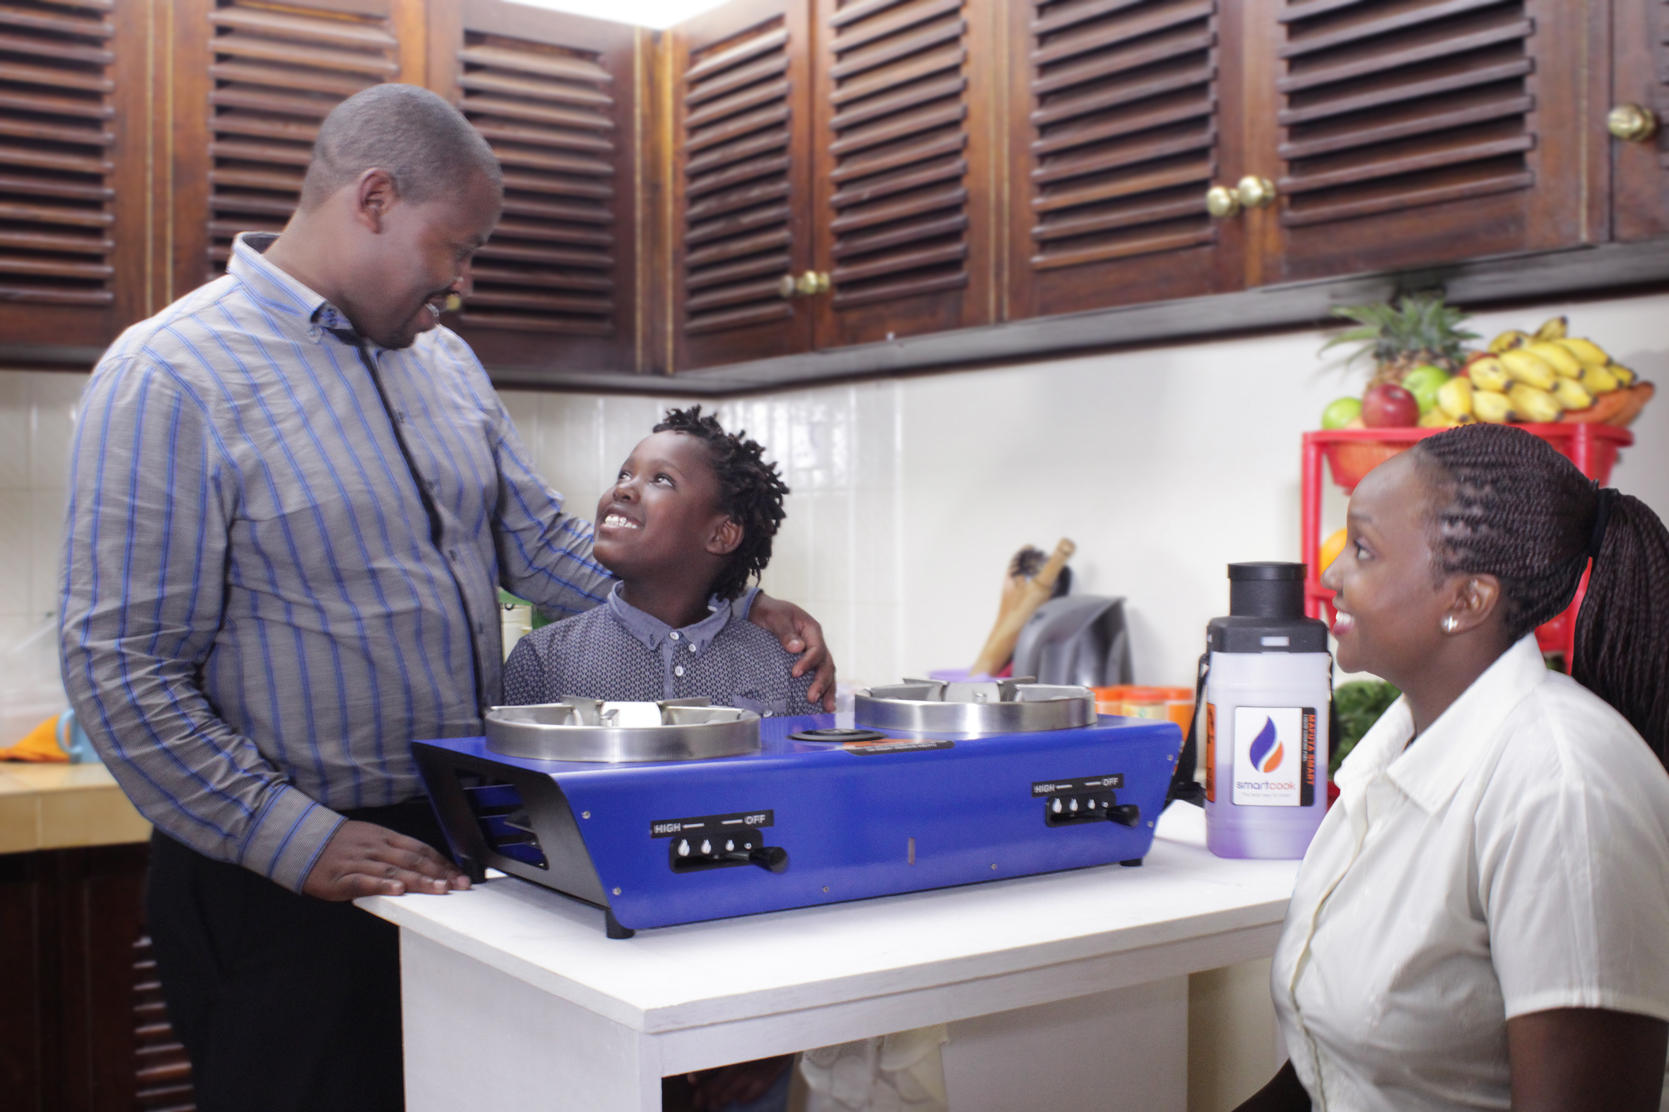
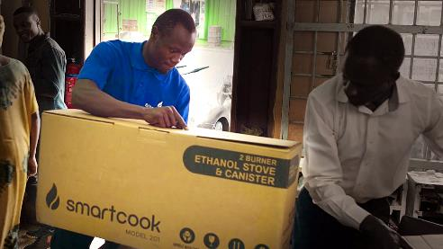


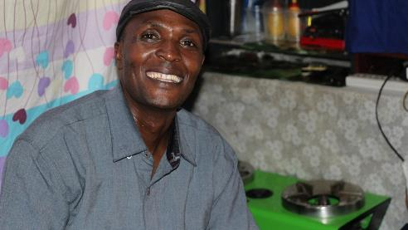
Our first consumer solution is “Smartcook”
This slide is fine as it is
HOW SMARTCOOK WORKS
AFRICA’S CITIES ARE EXPERIENCING RAPID GROWTH…
AGENTS
Agents
CUSTOMERS
Our first consumer solution is “Smartcook”
Customers

Slide 4
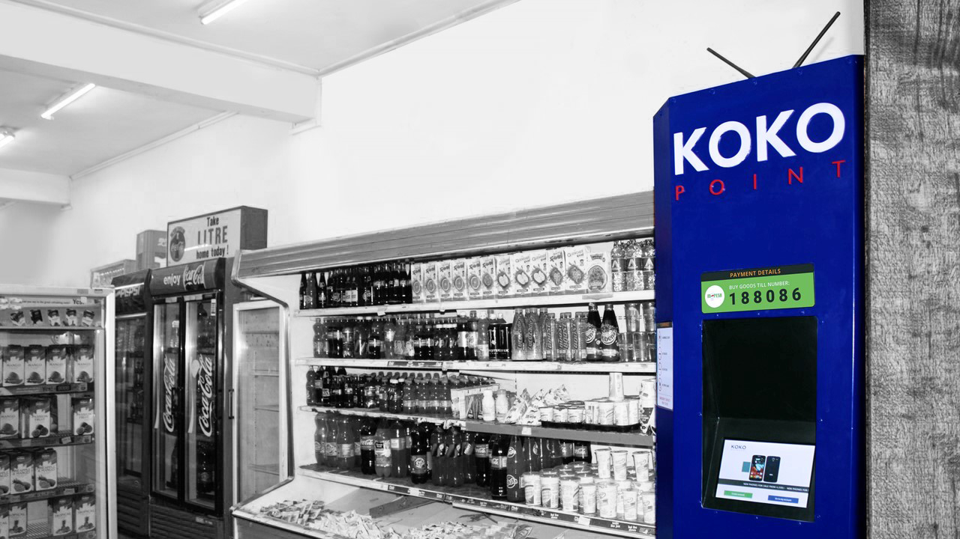
Smartcook is a new business opportunity for Nairobi retailers
Not sure what you think re design of this slide?
COSTS
Total Upfront Agency Fees: | KES 200,000
Business Loan to Agent*: | (KES 150,000)
Net upfront investment by Agent | KES 50,000
Costs
Total Upfront Agency Fees: KES 200,000
Business Loan to Agent*: (KES 150,000)
Net upfront investment by Agent KES 50,000
RETURNS
Direct Sales Commission | KES 250 per customer signed up by Agent
Margin on Fuel | KES 5 per litre
Returns
Direct Sales Commission KES 250 per customer signed up by Agent
Margin on Fuel KES 5 per litre
*Provided by KOKO’s banking partner
*Provided by KOKO’s banking partner

Slide 5
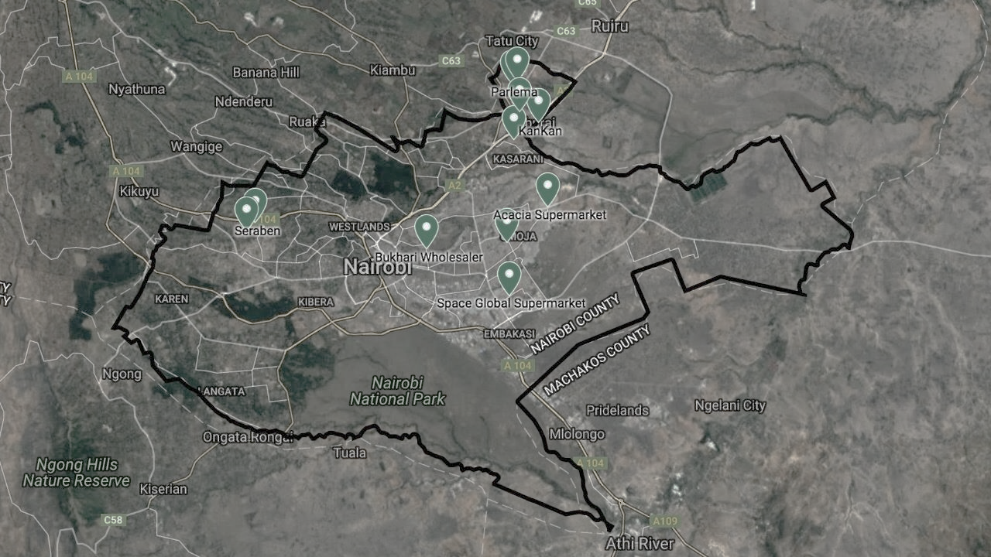

2017: “Soft Launch”
This slide is fine as it is

Slide 6
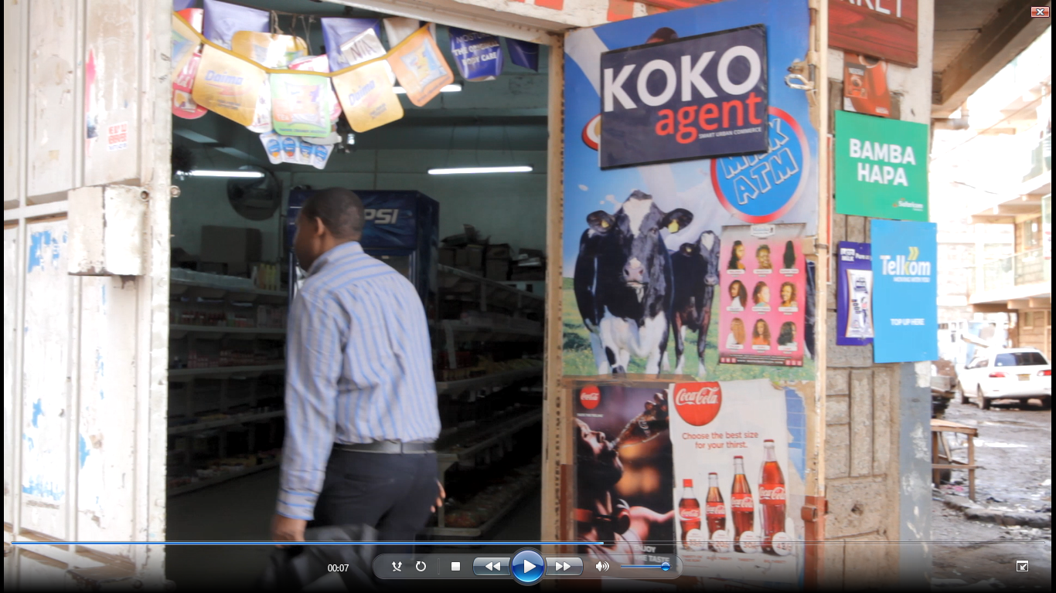
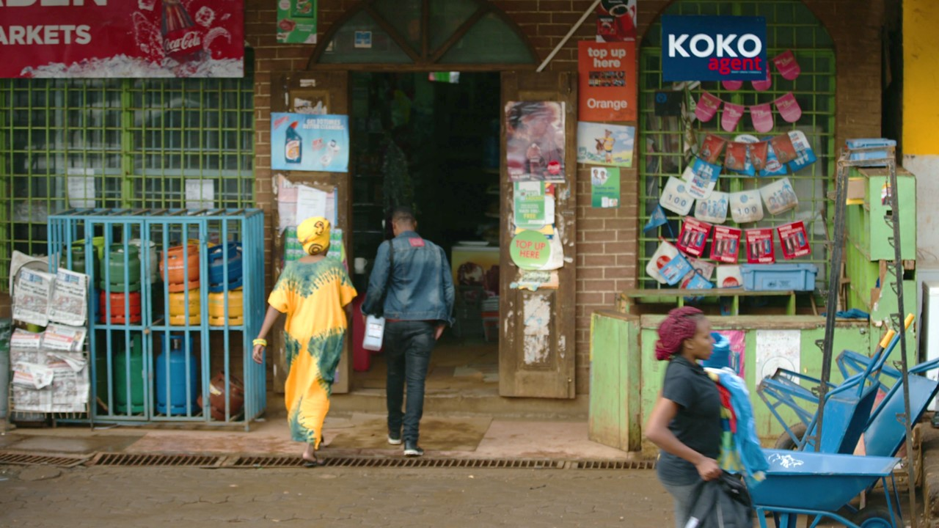
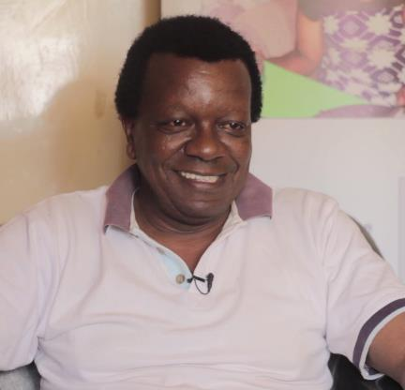
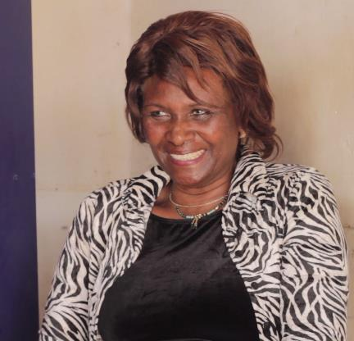
Agent & customer experience to date has been very positive
Ed to add video links
This slide is fine as it is
NAME SURNAME
Kankan Supermarket, Kahawa West
KOKO Agent since XX
HILDA SURNAME
Mum’s Milk & Oil ATM, Kahawa West
KOKO Agent since XX

Slide 7
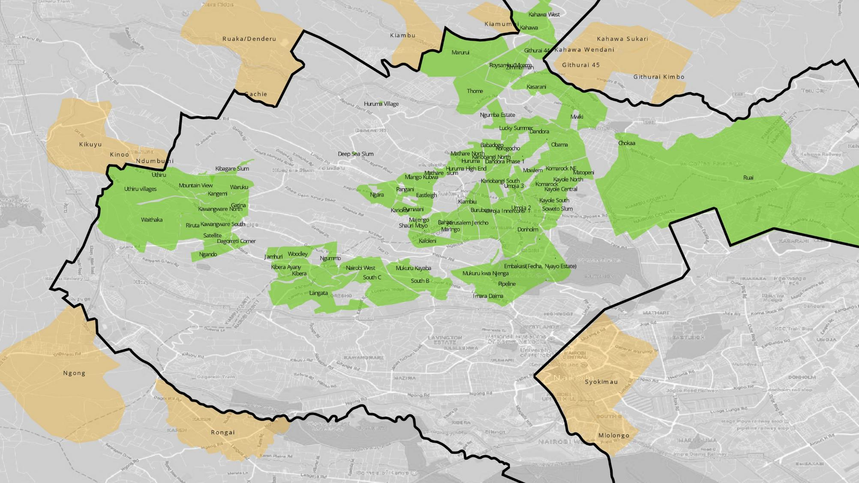
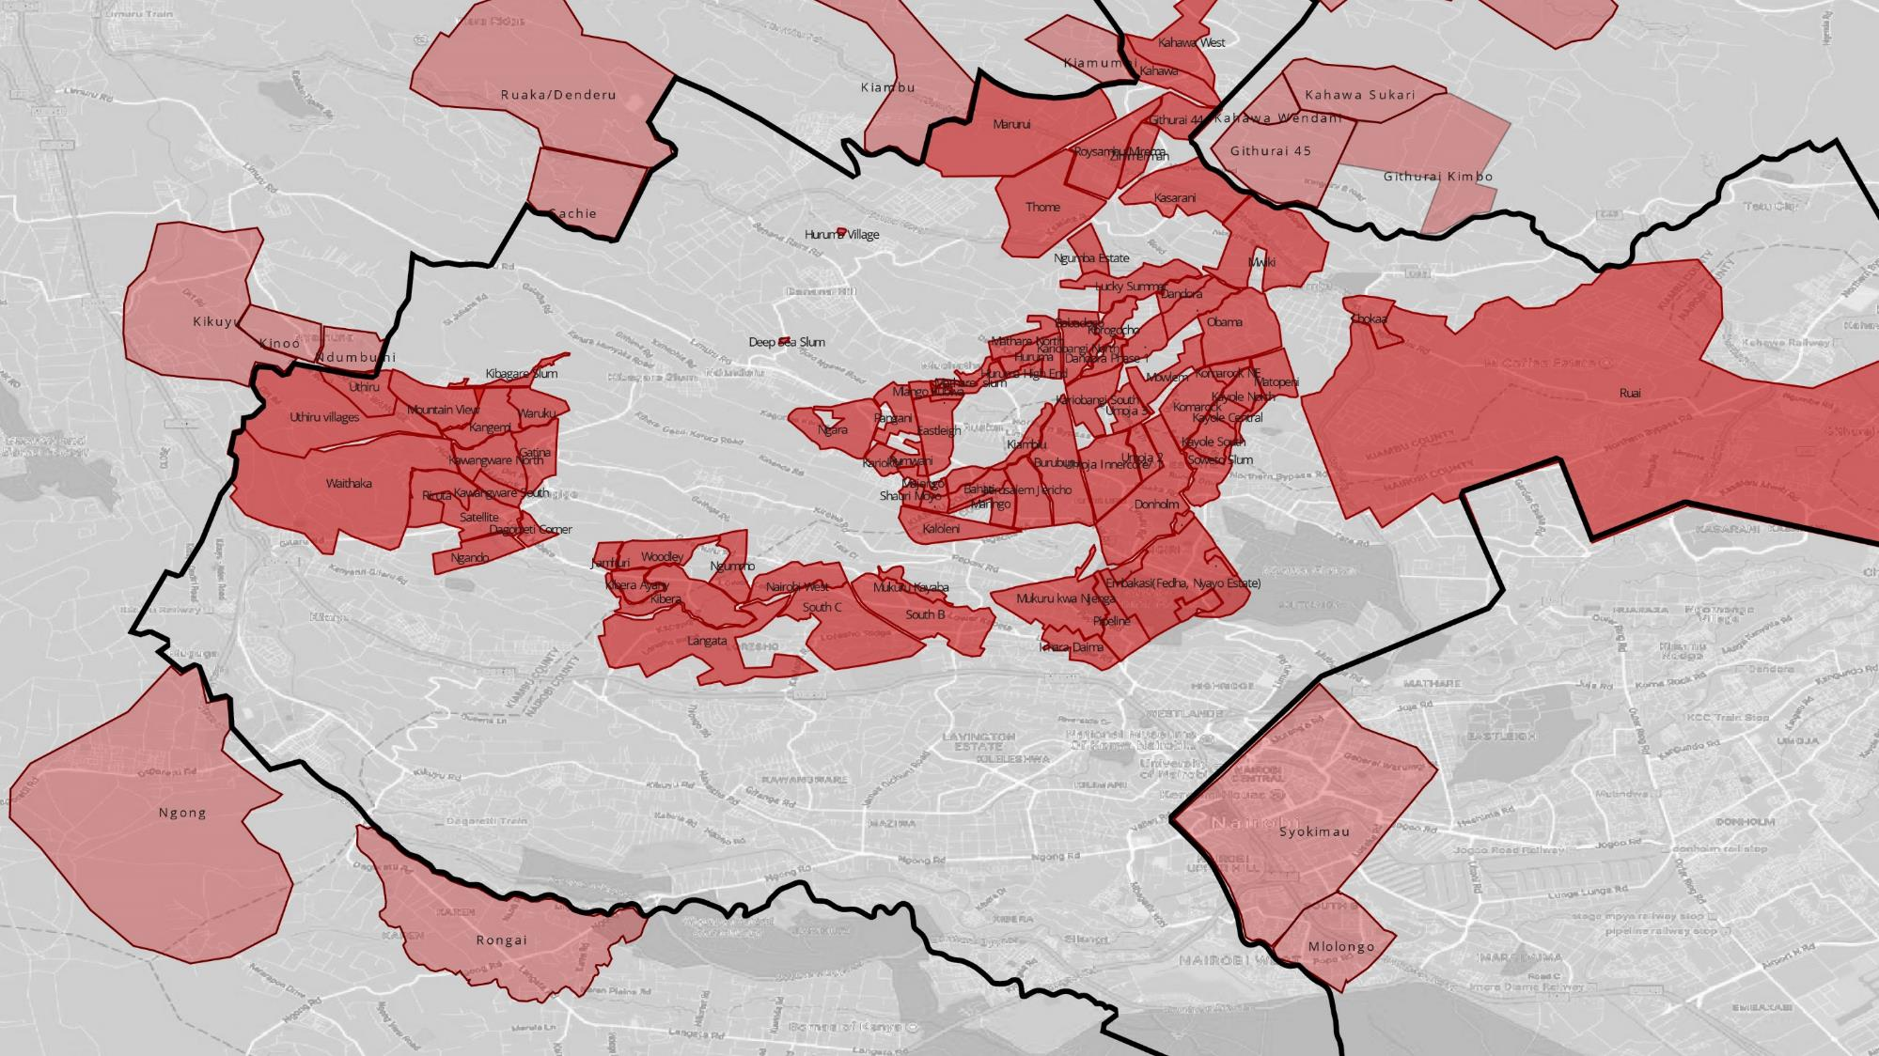
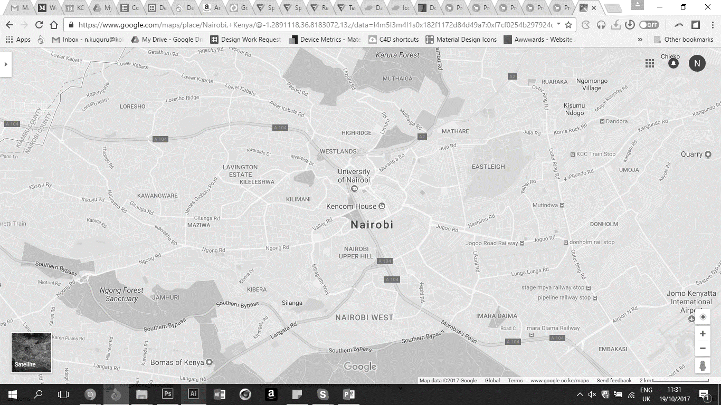
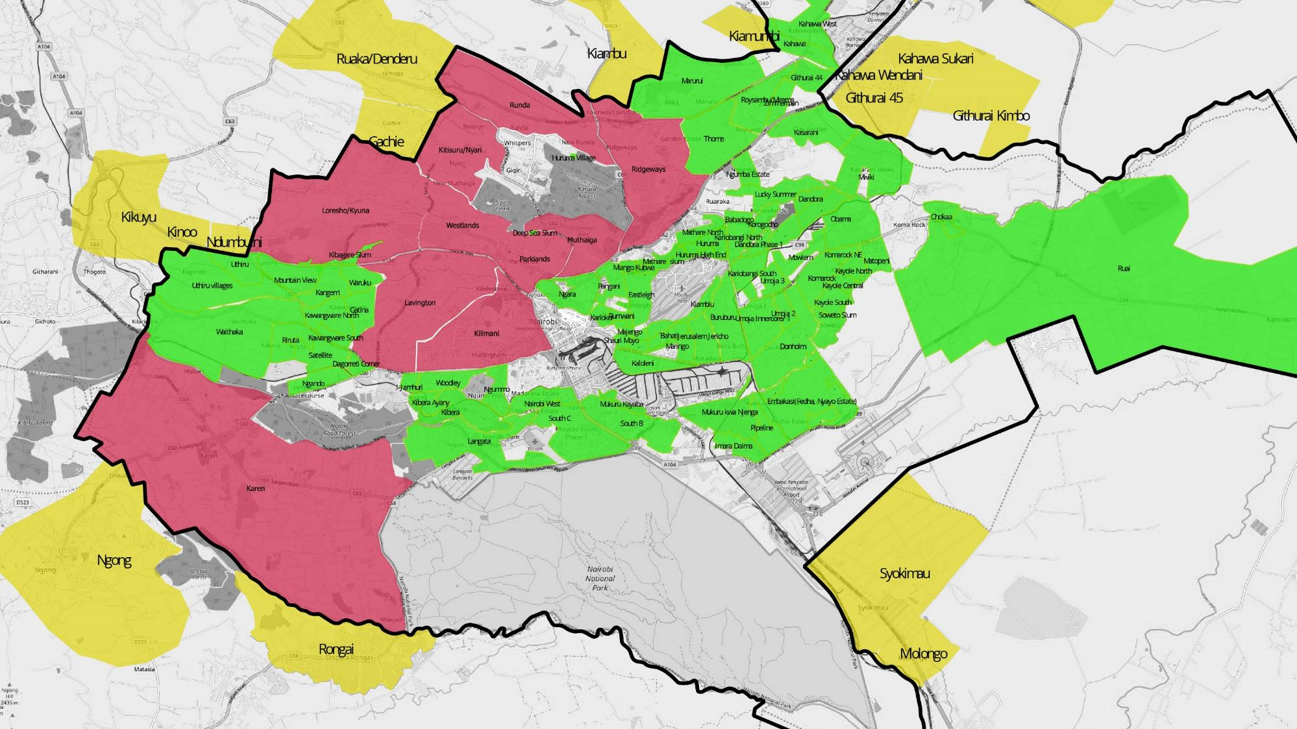

Hard Launch: 1,000 Agents in mid-2018
This slide is fine as it is
Full coverage across Greater Nairobi
Fuel Supplied by 10 Petrol Stations
Activated on “Day 1”
Major TV, Radio and Online marketing campaign

Slide 8
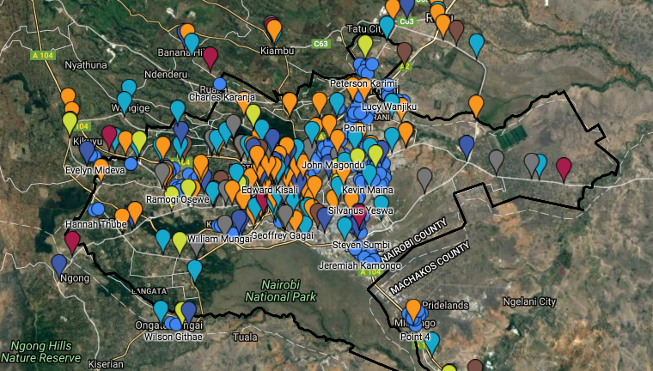
Agent Pipeline
This slide is fine as it is
ED IS AWAITING NEW MAP FROM AD
More than 500 shopkeepers have signed reservation agreements and placed deposits.
More than 500 shopkeepers have signed reservation agreements and placed deposits.

Slide 9
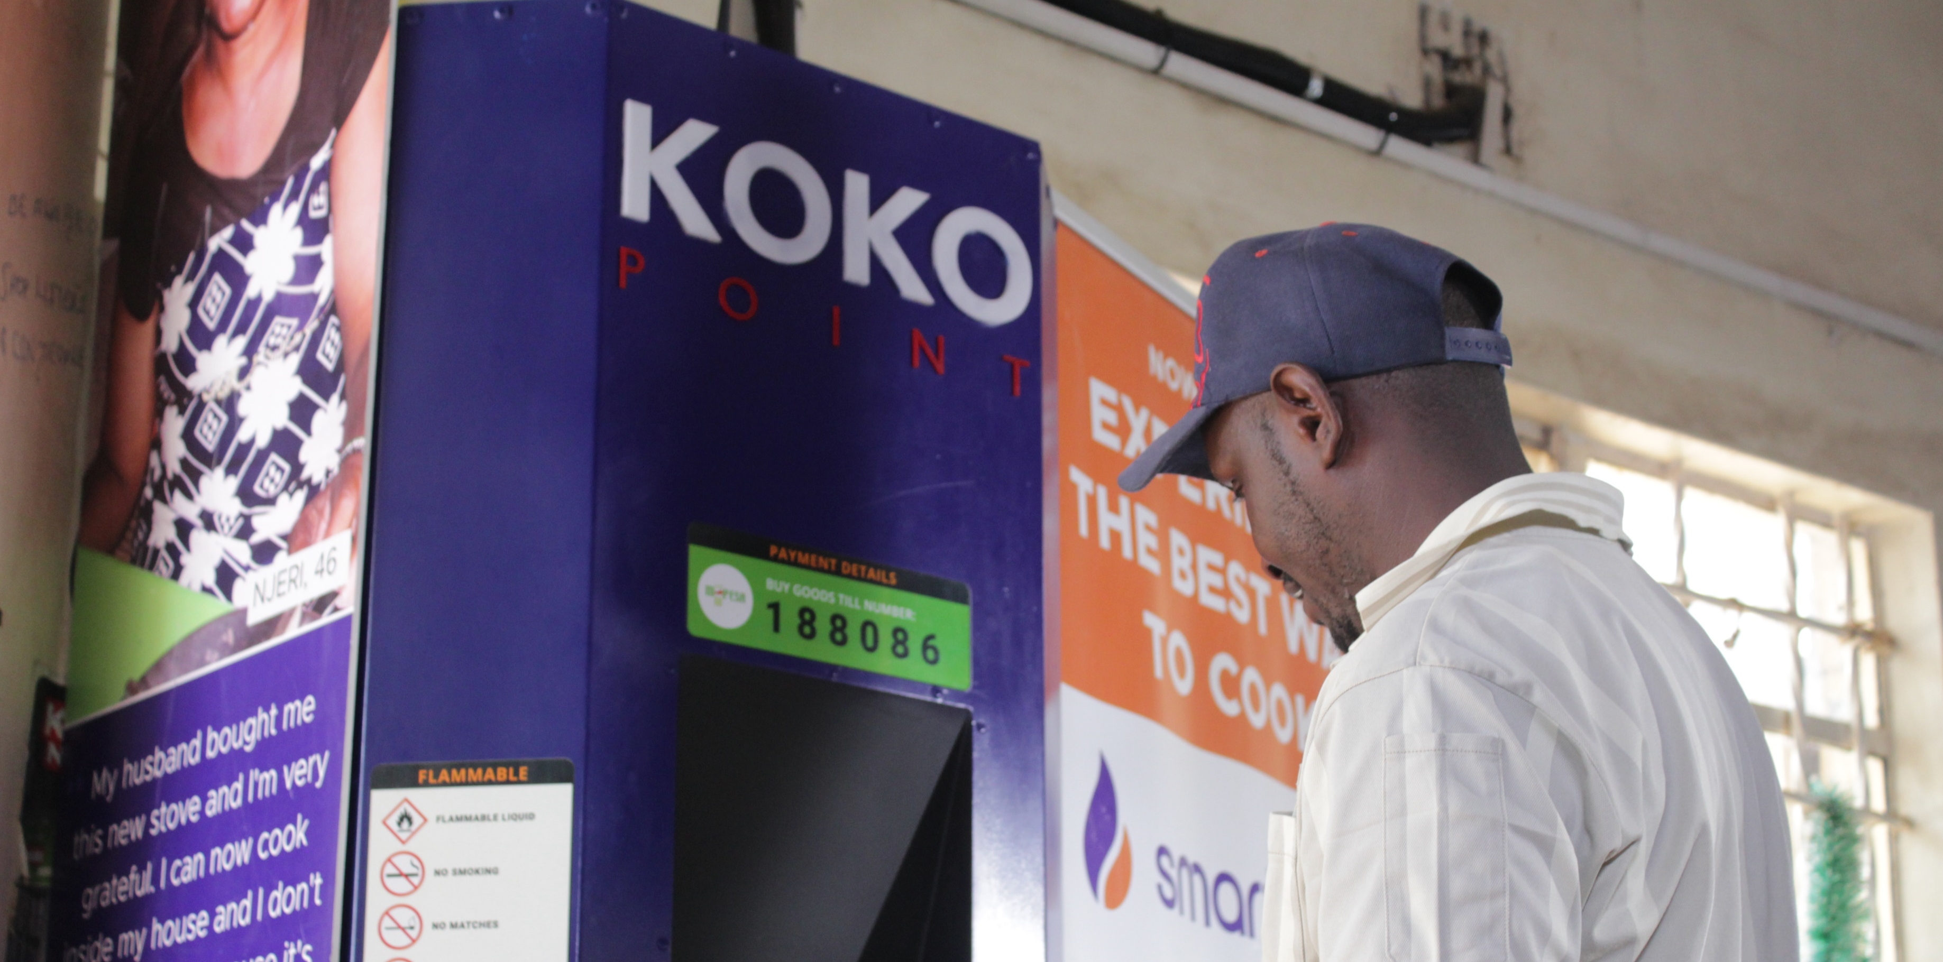
The Journey towards Hard Launch
Build Agent Pipeline
Loan Approvals
Loan Application Documents
Shop Inspection & Preparation
This slide needs design work
1
Build Agent Pipeline
2
Loan Application Documents
3
Loan Approvals
4
Shop Inspection & Preparation
5
KOKOpoint Installation
KOKOpoint Installation
Fill up KOKOpoints
Begin Taking Customer Orders
Hard Launch Day 1
6
Begin Taking Customer Orders
7
Fill up KOKOpoints
8
Hard Launch Day 1

Slide 10
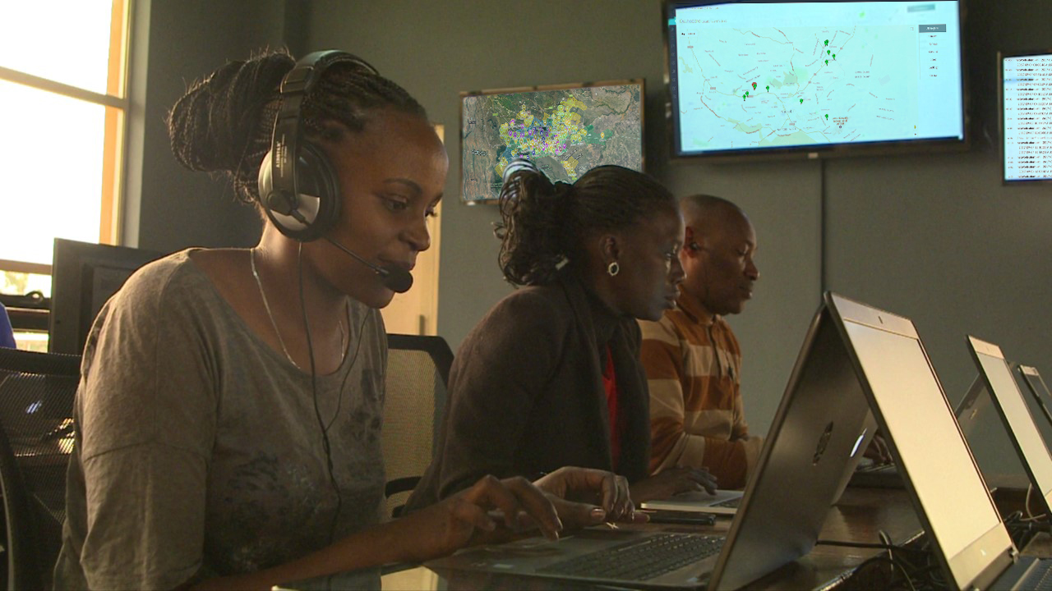
As we build towards Hard Launch (mid-2018), we will send all Agents monthly email updates
This slide is fine as it is
You can contact us any time, via:
[SMS]
[Phone]
[WhatsApp]

Slide 11
Nerica – not sure this slide works design-wise? Maybe it is the background picture?
We are an international technology company focused on solutions that improve life in urban Africa
Network HQs in Nairobi
Office + manufacturing facilities in Kenya + India
1st KOKO Network in Nairobi – then expansion across Kenya
Javan Munyiri Head of Agent Network
Amanda Donahue General Manager (Kenya)
Greg Murray Chief Executive Officer

Slide 12

This slide is fine as it is
Our first consumer solution is “SmartCook”
How SmartCook works for Customers + Agents

Slide 13
Our first consumer solution is “SmartCook”
This slide is fine as it is
AFRICA’S CITIES ARE EXPERIENCING RAPID GROWTH…
AGENTS
Agents
HOW SMARTCOOK WORKS
CUSTOMERS
Customers

Slide 14
Not sure what you think re design of this slide?
SmartCook is a new business opportunity for Nairobi retailers
Costs
Total Upfront Agency Fees: KES 200,000
Business Loan to Agent*: (KES 150,000)
Net upfront investment by Agent KES 50,000
Returns
Direct Sales Commission KES 250 per customer signed up by Agent
Margin on Fuel KES 5 per litre
*Provided by KOKO’s banking partner

Slide 15
2017: “SOFT LAUNCH”
This slide is fine as it is
2017: “SOFT LAUNCH”

Slide 16
Ed to add video links
Agent & customer experience to date has been very positive
This slide is fine as it is
(Name / Surname)
Kankan Supermarket, Kahawe West
KOKO Agent since XX
Hilda (Surname)
Mum’s Milk and Oil ATM, Kahawe West
KOKO Agent since XX

Slide 17
HARD LAUNCH: 1,000 Agents in mid-2018
This slide is fine as it is
Full coverage across Greater Nairobi
Fuel Supplied by 10 Petrol Stations
Activated on “Day 1”
Major TV, Radio and Online marketing campaign

Slide 18
This slide is fine as it is
AGENT PIPELINE
ED IS AWAITING NEW MAP FROM AD
More than 500 shopkeepers have signed reservation agreements and placed deposits.

Slide 19
Build Agent Pipeline
Loan Approvals
Loan Application Documents
Shop Inspection & Preparation
This slide needs design work
The journey towards Hard Launch
KOKOpoint Installation
Fill up KOKOpoints
Begin Taking Customer Orders
Hard Launch Day 1

Slide 20
As we build towards Hard Launch (mid-2018), we will send all Agents monthly email updates…
This slide is fine as it is
…and you can contact us any time, via:
[SMS]
[Phone]
[WhatsApp]

Slide 21
AMANDA – Agent referral programme
This slide is TBC, please wait for now on the design till I have worked on it with Amanda
We need your help – you’re def in the 1,000 cos you’re here
Outline deal terms: a, b, c (e.g. successful referral reduces your repayment by $50)

Slide 22
This slide needs design work
QUESTIONS ON SMARTCOOK?
You can also email us any time:
Javan Munyiri (Head of Agent Network): J.Munyiri@kokonetworks.com
Amanda Donahue (General Manager): A.Donahue@kokonetworks.com
Greg Murray (Chief Executive Officer): G.Murray@kokonetworks.com

Slide 23
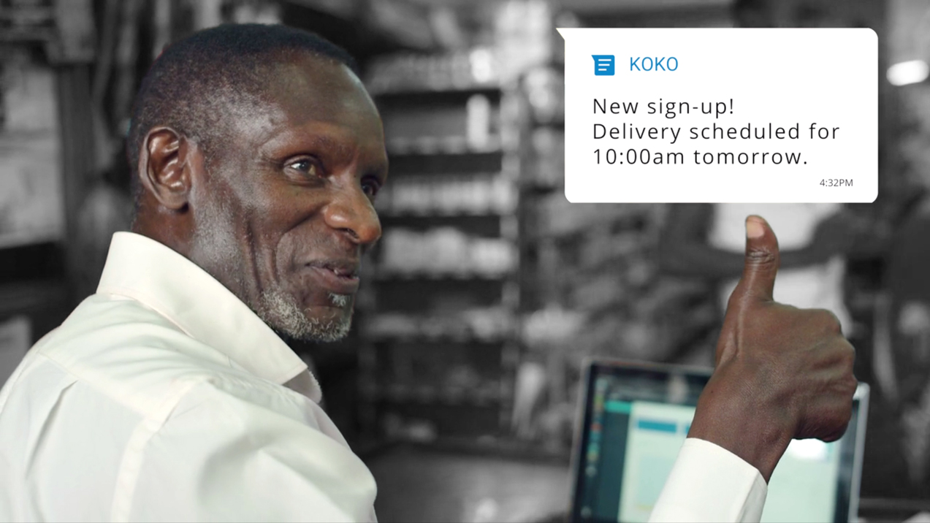
What is next, after SmartCook?
This slide is fine as it is
Our objective is to build and deploy technology that:
Increases your revenue
Reduces your costs
Enables you to grow and expand

Slide 24
NERICA – CAN WE HAVE 6x ICONS FOR THE 6 DIFFERENT FOCUS AREAS?
R&D FOCUS AREAS
BRINGING MORE CUSTOMERS INTO YOUR SHOP
ENCOURAGING THOSE CUSTOMERS TO BUY MORE
EXPANDING YOUR PRODUCT SELECTION AT LOW RISK
IMPROVING MARGINS ON YOUR PRODUCTS
REDUCING YOUR LOSSES FROM THEFT
REDUCING YOUR FINANCING COSTS

Slide 25
Ignore this slide for now
Technology can bring you more customers and more sales
Some sort of pics and headlines about retail POS tech, customer database, WeChat / WhatsApp Social Commerce, Ule example
What if you there was a way to offer your customers a discount of KES XX on, for example, Blue Band margarine, paid for Unilever and with that discount available TODAY ONLY from KOKO agents?
Example 1 of 3 – C/F next slide, keep hypothetical / high-level – nice headline etc

Slide 26

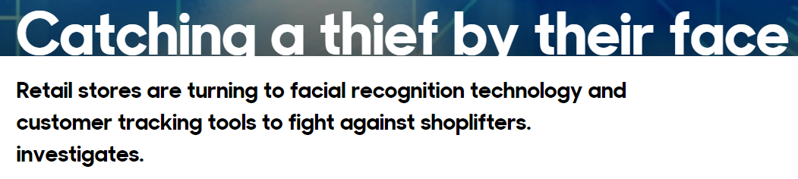

This slide needs design work
Technology can reduce your losses from shoplifters
Facial Recognition Tech
References “blacklist” of prior offenders
Causes immediate alarm on entry

Slide 27
Ignore this slide for now
Technology can reduce your working capital financing costs
Some sort of pics and headlines about cost of working capital for traders and merchants in Africa
What if there was a way to bring you more working capital finance at lower interest rates, to help you expand your business?

Slide 28
Applied research – listening to our partners – business challenges, “Pain Points”
Develop technology product idea
Test idea with partners – discard non-viable ideas
Rapidly build and test prototypes (multiple cycles, iterative)
This slide needs design work
How we develop technology
Refine, finalize design, build world-class technology
Hard Launch
Soft Launch and test in “the real world” – minor tweaks and improvements

Slide 29
NERICA – TEXT IS TBC, BUT PLS CAN YOU THINK ABOUT HOW THIS SLIDE MIGHT BE DESIGNED / A BACKGROUND PHOTO OR PICTURE?
Help us help you!
We are looking for retail partners to participate in this R&D program
XX shopkeepers
happy to share their experiences, challenges and pain points
happy to share their retail store sales and inventory data
participate in focus groups, provide feedback on products as they develop
What we offer in return for this R&D participation:
- (TBD)

Slide 30
This slide needs design work
QUESTIONS?
You can also email us any time:
Javan Munyiri (Head of Agent Network): J.Munyiri@kokonetworks.com
Amanda Donahue (General Manager): A.Donahue@kokonetworks.com
Greg Murray (Chief Executive Officer): G.Murray@kokonetworks.com

